Slide 1


Managing VMware infrastructure with SaltStack Cloud Management
Nitin Madhok, Systems Developer, Clemson University
GitHub: @nmadhok Twitter: @_nmadhok_ LinkedIn: https://www.linkedin.com/in/nitinmadhok
#SaltConf16 #Clemson #ClemsonTigers

Slide 2

whoami
couple of things about me …
Spoken at various conferences including SaltConf15, OpenStack Summit 2015 (Tokyo), SaltConf16 etc.
Some of the significant contributions made include making Salt compatible with Python 3, creating salt-cloud VMware driver, creating DNS/ASAM/Spacewalk runners, creating ZFS/Zpool modules, maintaining saltstack-formulas etc.

Slide 3
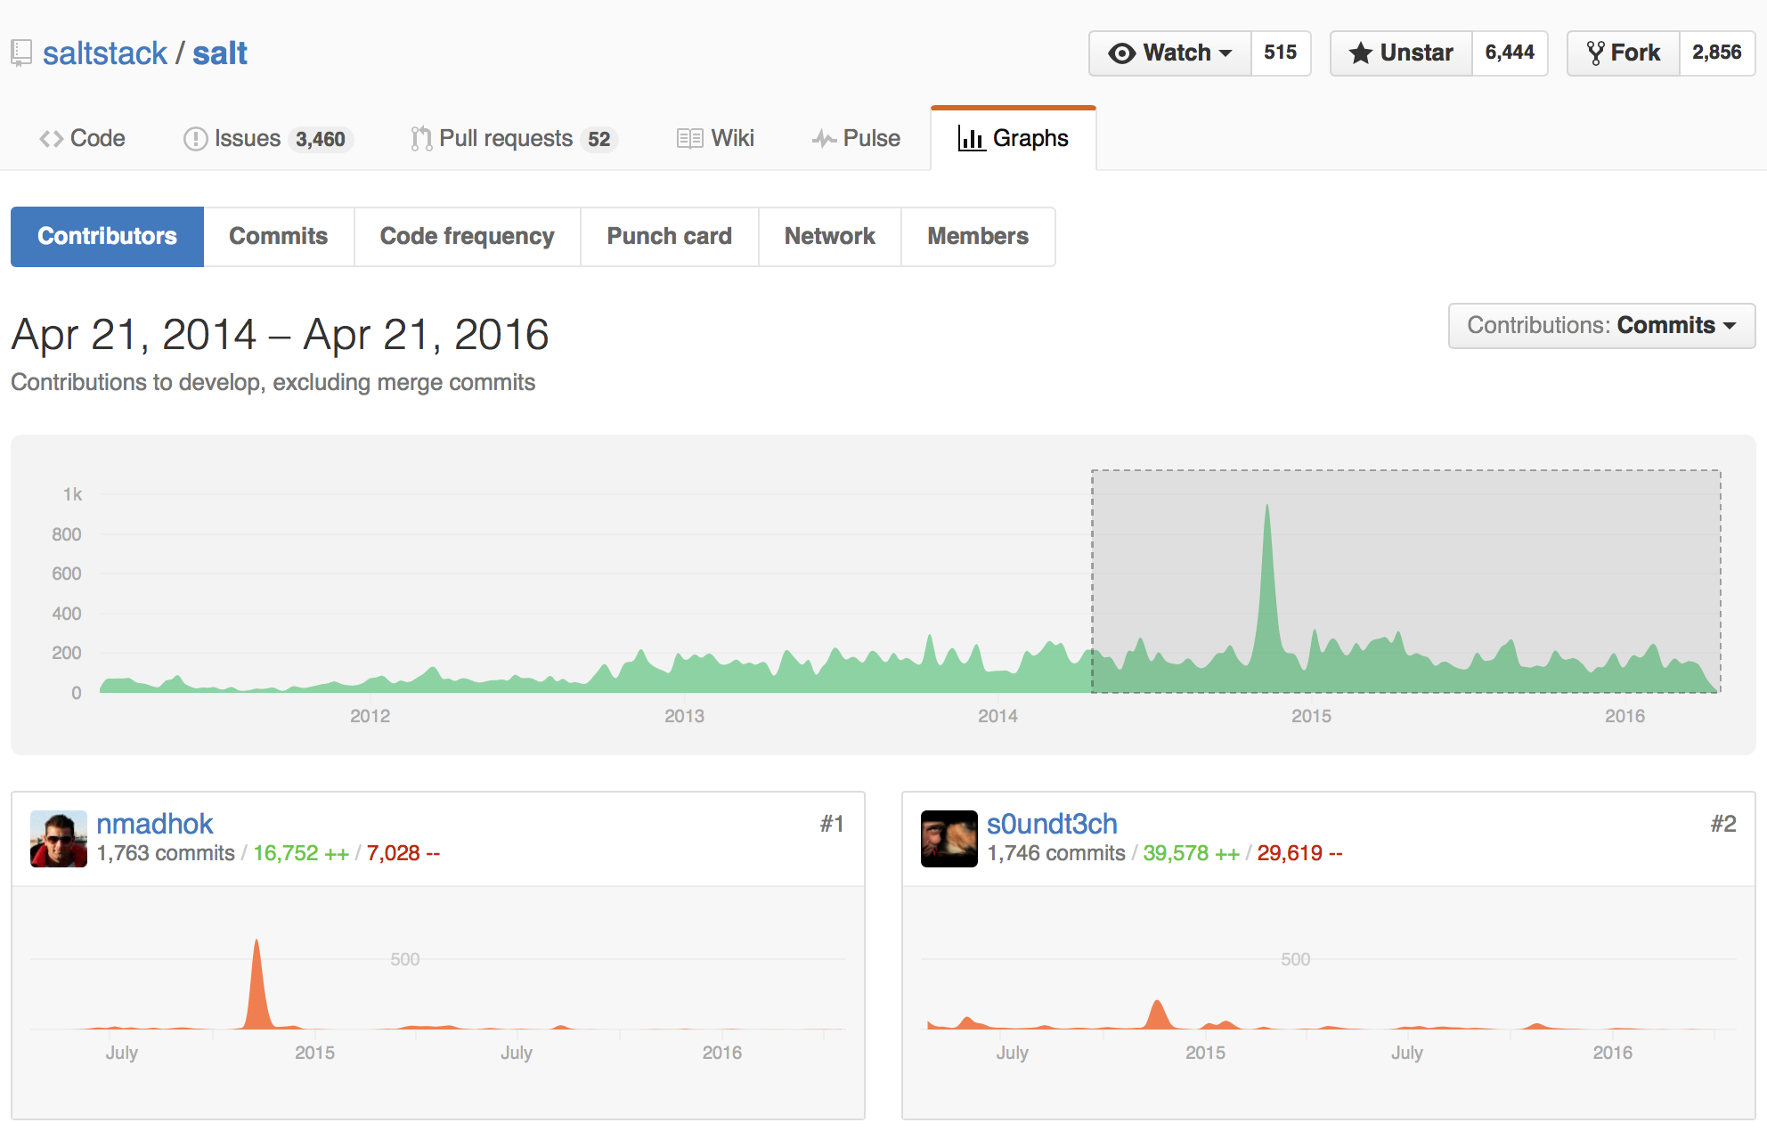
whoami
couple of things about me …
#1 rank by commits for contributions made to SaltStack projects within the past two years!

Slide 4

agenda
what we will cover …
What is salt cloud?
Basic terminology
Providers
Profiles
Maps
Live demo using salt-cloud with VMware

Slide 5
salt-cloud
what is it? why was it created?
It is a private/public cloud provision tool
Integrates salt with cloud providers
Makes modeling and provisioning of minions quick and easy
Initially created to automatically accept keys on the master
Current integration with AWS, Azure, DigitalOcean, Google Compute Engine, HP Cloud, OpenStack, Rackspace, SoftLayer, VMware and many more!

Slide 6
basic terminology
providers? profiles? maps?
Provider contains cloud provider related information. Default location is /etc/salt/cloud.providers
Profile contains VM related information. Default location is /etc/salt/cloud.profiles
Map can be used to specify multiple VM’s using the same profile. Default location is /etc/salt/cloud.map

Slide 7
Live Demo
Learn how to set up, configure, manage your VMware environment and deploy VMs using salt-cloud
Presentation content at:
https://github.com/nmadhok/saltconf16

Slide 8
Thank you
Please provide session feedback using the SaltConf16 event app
Follow me on:
GitHub: @nmadhok Twitter: @_nmadhok_ LinkedIn: https://www.linkedin.com/in/nitinmadhok
#SaltConf16 #Clemson #ClemsonTigers

